Slide 1
The Antibiotic Battleground: Fighting Sepsis in Rural Emergency Departments
Presentation by Ariane Smedley and tahlia stIckley
Notes:
Goodevening everyone. My name is Tahlia and this is Ariane and today we are talking to you about “The Antibiotic Battleground: Fighting Sepsis in Rural Emergency Departments”.

Slide 2
What is Sepsis? “life-threatening organ dysfunction caused by a dysregulated host response to infection”.
Notes:
So what actually is sepsis? Well, sepsis was redefinied in 2016 as “life-threatening organ dysfunction caused by a dysregulated host response to infection”. An quick way to identify patients with who are likely septic is the qSOFA score. Patients are qSOFA positive if they are two or more of following; hypotensive, tachypnoeic, and have an altered mental status. A positive qSOFA score is associated with a 10% mortality risk.
Sepsis affects 48.9 million people worldwide every year, with at least 20% of cases resulting in death. As we all know, for patients with suspected sepsis, early initiation of appropriate antibiotics is key. But are we prescribing antibiotics correctly? But are we prescribing antibiotics correctly? A study of a tertiary Queensland ED found that only 63.1% of adult patients were prescribed appropriate antibiotics. But what about in regional and rural hospitals, where antimicrobial stewardship programmes are often less established or supported?

Slide 3
Aim
Investigate antibiotic guideline concordance for sepsis within rural Queensland hospital emergency departments.
Today’s presentation: a preliminary analysis of 2 sites
Notes:
The aim of our study is to investigate antibiotic guideline accordance for sepsis within Queensland hospital emergency departments. Today’s presentation is a preliminary analysis of antibiotic appropriateness across 2 rural sites. However the end goal of this research study will incorporate 5 rural QLD sites and will explore multiple aspects of how we are managing sepsis in the rural ED.

Slide 4
Method
Retrospective audit of patient records
Presentations to regional EDs – clinical diagnosis of sepsis
1 Jan 2017 – 1 June 2020
Age > 18
2 sites in rural Queensland
Start: Jan 2017
Site B Start: Oct 2018
End: Jun 2020
Notes:
This study has been a retrospective review of adult patients diagnosed with sepsis in rural Emergency Departments. Patients presenting to the ED between 1 Jan 2017 to 1 June 2020 with a clinical diagnosis of sepsis as identified by EDIS coding were included in the study. Initial presentation date was selected in keeping with the 2017 change to the sepsis criteria. It is worth noting that due to the volume of data and time constraints one of the two sites included in our preliminary analysis includes data only from October 2018 to the Jun 2020. Patients under the age of 18 were not included for the purpose of this audit. Information was collected both from the viewer and paper charts including reviewing the original medication charts for each patient.

Slide 5
Data Collected
Patient demographics
Patient outcomes - including transfers & mortality
Comorbidities
Vital signs
Bloods
Cultures
IV antibiotics – dose + time
Vasopressors
Consults
Notes:
A wide variety of data was collected for each patient’s presentation to ED. Notably data was collected on patient outcomes including transfers and mortality. Vital signs during ED admission. Bacterial cultures for antibiotic sensitivity and the IV antibiotics they were given including dose and time.

Slide 6
Appropriateness Criteria - NAPS
APPROPRIATE | 1 | Optimal | Optimally follows eTG
 | 2 | Adequate | A reasonable alternative
INAPPROPIATE | 3 | Suboptimal | An unreasonable choice
 | 4 | Inadequate | Unlikely to treat
Notes:
This brings us to discussing the appropriateness criteria used for our analysis. Appropriate and inappropriate antibiotic selection was classed based on the categories you see here from the national antibiotic prescribing survey or NAPS. Appropriate antibiotics are either considered optimal whereby they are in keeping with the therapeutic guidelines or adequate whereby a reasonable alternative from the therapeutic guidelines is selected for the likely causative pathogens.
Inappropriate antibiotics are similarly split into 2 categories; suboptimal and inadequate. Suboptimal includes an unreasonable choice of antibiotic or a mild or non-life threatening allergy mismatch. Inadequate includes a choice that is unlikely to treat the likely causative agent or a severe or possibly life threatening allergy mismatch.
For our preliminary analysis antibiotic appropriateness categorisation was conducted by an ex-ID pharmacist with review from a rural generalist. Future results will be reviewed by an infectious diseases physician.

Slide 7
Method - Statistics
Summary statistics including percentages, as appropriate
Chi-Squared test, 95% confidence intervals using Wilson’s score interval
ANOVA or Kruskal-Wallis as appropriate
Logistic regression and odds ratios for assessing antibiotic inappropriateness risk factors
Statistical significance p < 0.05
Notes:
As you can see here we’ve used a number of statistical methods to analyse the data, in keeping with an observational retrospective study. Logistical regression and odds ratios were also conducted to identify risk factors for inappropriate antibiotic prescribing. For the purpose of this presentation we have also included summary statistics as appropriate.

Slide 8
Results: The Patients
Total (n) Site A Site B | 166 58 108
Gender | Male = 96, Female = 70
Age (Average) | 68 (range 18 – 96)
Antibiotic allergy | 34 (20.4%)
qSOFA positive | 56 (33.7%)
Died in hospital | 16 (9.63%)
Transferred | 57 (34.3%)
Discussed with ID | 19 (11.4%)
Notes:
Here we have summarised some of the patient information collected during our audit. Our preliminary analysis was undertaken with 166 patients across 2 sites. The 166 patients were made up of 96 males and 70 females with an average age of 68 20% of these patients had a known antibiotic allergy. 34% of patients had a positive qSOFA indicating they were at high risk for in-hospital mortality. Overall, 10% of the total patients died in hospital. Looking at other patient outcomes 34% of patients were transferred, and only 11% of the total cases were discussed specifically with infectious diseases.

Slide 9
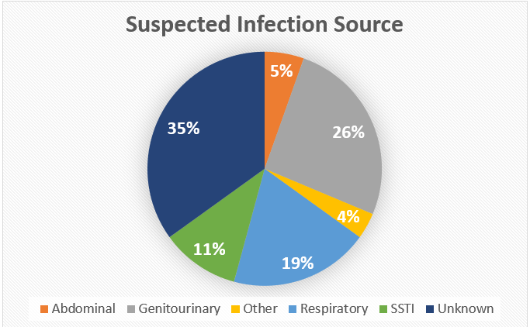
Notes:
So what were the most commonly suspected sources of infection in our patients? 1/3 of the patients had an unclear source of infection, with genitourinary and respiratory being the 2nd and 3rd most common suspected sources. It is important that a suspected infection source is identified as this does impacts on which empirical antibiotics are most appropriate.

Slide 10
Antibiotic Appropriateness:
46% (95% CI 38-53)
Notes:
Based on our preliminary analysis patients presenting to the rural Emergency Departments received guideline concordant antibiotics in 46% of cases.
This means that critically ill patients who require the best of antibiotic therapy are getting the appropriate treatment less than half the time. Therefore, the majority of the patients received inappropriate antibiotics that either were an unreasonable choice of antibiotic or alternatively were an allergy mismatch for the patient.

Slide 11
Antibiotic Appropriateness
Notes:
This 46% is made up of category 1 and 2 totalling 76 patients. The most common category as you can see was suboptimal category 3 where an unreasonable choice was made.
It is also worth noting that there were 4 instances of patients who fell into category 4 who had severe or life-threatening allergy mismatches one of whom required adrenaline as a result of anaphylaxis to an inappropriately prescribed penicillin. As doctors we cannot afford to be making patients who are critically unwell worse through medication errors like this.

Slide 12
Patient characteristics stratified by antibiotic appropriateness category
Appropriateness grade​ |  | 1​ | 2​ | 3​ | 4​ | p​
Age (median [IQR])​ |  | 70.00 [55.50, 84.50]​ | 79.00 [70.00, 83.00]​ | 75.00 [58.25, 81.75]​ | 66.50 [50.00, 80.75]​ | 0.705​
Admission Source (%)​ | Independent​ | 45 ( 76.3) ​ | 13 ( 76.5) ​ | 58 ( 67.4) ​ | 2 ( 50.0) ​ | 0.488​
 | Low-care​ | 8 ( 13.6) ​ | 1 ( 5.9) ​ | 16 ( 18.6) ​ | 1 ( 25.0) ​ | 0.521​
 | High-care​ | 6 ( 10.2) ​ | 3 ( 17.6) ​ | 12 ( 14.0) ​ | 1 ( 25.0) ​ | 0.731​
Died in Hospital (%)​ |  | 4 ( 6.8) ​ | 2 ( 11.8) ​ | 9 ( 10.5) ​ | 1 ( 25.0) ​ | 0.616​
qSOFA (%)​ | 0​ | 14 ( 23.7) ​ | 2 ( 11.8) ​ | 14 ( 16.3) ​ | 2 ( 50.0) ​ | 0.063​ ​ ​ ​
 | 1​ | 33 ( 55.9) ​ | 7 ( 41.2) ​ | 38 ( 44.2) ​ | 0 ( 0.0) ​
 | 2​ | 5 ( 8.5) ​ | 4 ( 23.5) ​ | 23 ( 26.7) ​ | 2 ( 50.0) ​
 | 3​ | 7 ( 11.9) ​ | 4 ( 23.5) ​ | 11 ( 12.8) ​ | 0 ( 0.0) ​
Creatinine (median [IQR])​ |  | 94.00 [75.50, 139.50]​ | 142.00 [85.00, 227.00]​ | 105.50 [84.75, 170.50]​ | 136.00 [111.00, 142.75]​ | 0.156​
Lactate (median [IQR])​ |  | 1.96 [1.40, 3.25]​ | 2.25 [1.37, 5.70]​ | 2.00 [1.20, 3.20]​ | 3.51 [2.09, 4.75]​ | 0.441​
Systolic BP (mean (SD))​ |  | 113.59 (29.40)​ | 104.35 (23.87)​ | 106.31 (27.85)​ | 107.75 (27.96)​ | 0.421​
Notes:
Moving on to further data analysis. This table shows various patient characteristics stratified by the NAPs antibiotic appropriateness categories. As can be seen by the p values in the far right column, our preliminary research shows that there are no statistically significant differences between groups.

Slide 13
Dosing
314 antibiotic prescriptions
63.4% appropriately dosed
Ceftriaxone: 1g given not 2g
Gentamicin: underdosed for weight
Notes:
Among the 166 patients in this sample there were 314 antibiotic prescriptions, 63.4% of which were appropriately dosed.
When comparing which antibiotics were most frequently inappropriately dosed ceftriaxone and gentamicin stood out most obviously.
Ceftriaxone was often dosed at 1g per 24 hours rather than the 2g that new evidence suggests is required for minimal inhibitory concentration. Gentamicin was similarly underdosed as patients received less than 7mg/kg. Weight was often not recorded on medication charts so it is possible this underdosing was as a result of prescribing habit for particular doses rather than a calculation error.

Slide 14
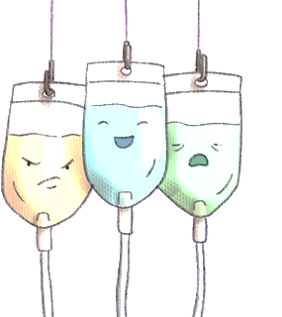
Some observations so far…
24 patients received ceftriaxone and gentamicin for genitourinary infections - unnecessary double coverage of gram-negative bacteria
Piperacillin/tazobactam prescribed inappropriately
Used for respiratory sources which is considered excessive
Used for unknown source or skin/soft tissue infections, with no reliable S. aureus coverage
Notes:
So what does the data tell us specifically about how we are prescribing antibiotics for sepsis? 24 patients received both ceftriaxone and gentamicin. However, prescribing these antibiotics together is unnecessary double coverage of gram-negative bacteria. Piptaz was another antibiotic which was commonly prescribed inappropriately for 2 reasons. Firstly, it was used for respiratory tract infections which is generally considered excessive. Secondly, it was used for sepsis of unknown origin or for skin/soft tissue infections, but Piptaz does not have reliable S. aureaus coverage and is thus inappropriate.

Slide 15
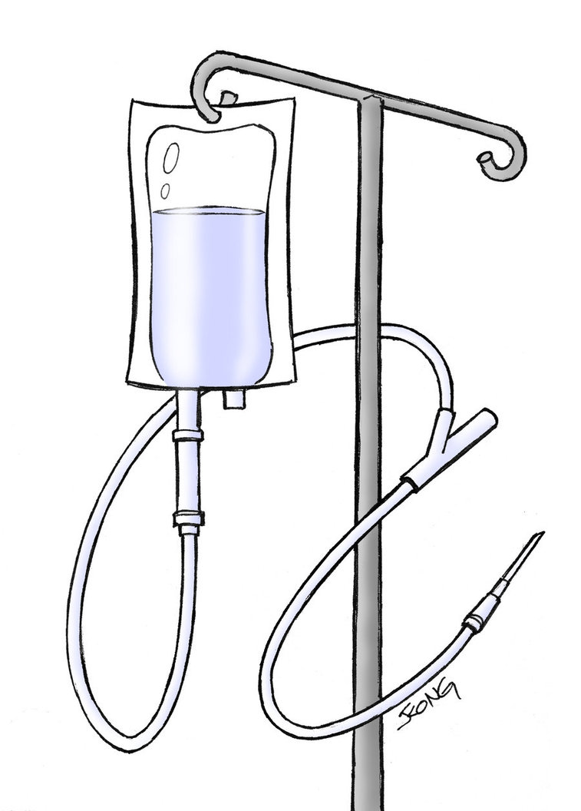
Risk factors for inappropriate antibiotics?
No statistically significant association with any variable
→ No identified risk factors
Notes:
A logistical regression analysis showed that there was no significant associations between any of the patient demographics, comorbidities, vital signs, infection source, test results or whether they presented during business hours and antibiotic appropriateness. This means that the study did not indentify any risk factors (small sample size) which made patients more likely to be prescribed inappropriate antibiotics.

Slide 16
Take Home Points
Most common suspected infection source: unknown and genitourinary
Only 46% of patients received appropriate antibiotic therapy
Inappropriate dosing of ceftriaxone and gentamicin
No risk factors identified for inappropriate prescribing
Notes:
While we are still in the early stages of data collection, our preliminary analysis still demonstrates some important messages. Only 46% of patients received appropriate antibiotics in the rural EDs, compared to 63% in tertiary hospitals, meaning that over half of these critically ill, rural patients are receiving suboptimal and inadequate therapy. The 2 most common infection sources were unknown, followed by genitourinary. Ceftriaxone and gentamicin were the antibiotics dosed most inappropriately. No particular risk factors were identified in association with inappropriate prescribing.

Slide 17
Where to from here?
Continue data collection to increase power
Effect of inappropriate antibiotic therapy in sepsis on patient outcomes
Risk factors for patient outcomes
Time to antibiotic therapy?
How do we improve antibiotic prescribing in rural hospitals?
Access to education, resources and specialist support
Notes:
So where to from here? Well with that number, 46%, in mind, we’d like to explore what effect that inappropriate antibiotic therapy has on patient outcomes. To do this we need to continue data collection, to increase our power for appropriate statistical analysis. We’d also like to explore whether there are any risk factors for patient outcomes, such as time to ABx therapy. Furthermore, we’d like to identify any ways in which we can improve antibiotic prescribing in rural hospitals. This way we can tailor prescriber education, resources and specialist support to fill in the gaps and get a better number than 46%, to improve patient outcomes.

Slide 18
Acknowledgements
Aaron Heffernan
Dr Janini Pinidiyapathirage
Dr Brendan Carrigan
Dr Kay Brumpton
Dr Mark Beale
Dr Rob Heffernan
Student investigators: Sharon Oomen, Jacqui Holland and Emma Van-Hougenhouck-Tulleken
Notes:
We’d like to thank everyone listed on the slide for their hard work and contribution to this project, in addition to QRME and Griffith for the ongoing support.

Slide 19
Questions

Slide 20
Site comparison
Notes:
While with our preliminary data only being from two rural sites it is worth contrasting these sites to see if the trends are site specific.

