Slide 1
Antibiotic prophylaxis use in surgery performed in South East Queensland rural hospitals
Dr Sachith Nanayakkara, Ben Thurgood, Ben Marsden, Cameron Mills

Slide 2
Background
Prophylactic use of antibiotics is an essential component in most surgeries to prevent surgical site infections and complications.
Patients with SSI remain in hospital an average of 20.3 days longer compared to those without an infection (ACSQHC, 2018). This increased length of stay cumulatively totals $42,102 in extra costs for the Government per patient (ACSQHC, 2018)
Australian Commission on Safety and Quality in Health Care (ACSQHC) 3% of surgeries result in SSI
Multiple audits across Australian hospitals have shown varying degrees of adherence to SAP, with the lowest adherence rates at 16.5% (Bull et al., 2006, Knox et al., 2016, Friedman et al., 2013)
Low compliance to therapeutic guidelines is often observed in Australia. In rural locations, particularly in Queensland, there is a limited amounts of data available to identify compliance and gaps in using antibiotic prophylaxis during surgeries.

Slide 3
Aim
Determine compliance in using antibiotic prophylaxis during surgeries performed in Gympie, Dalby and Kingaroy general hospitals between 1st January 2020 and 30th April 2021

Slide 4
Objectives
Primary Objective:
Compare adherence of prophylactic antibiotic use in each type of surgery at each site against therapeutic guidelines.
Secondary Objectives:
Identify types of surgeries performed at Gympie, Dalby and Kingaroy general hospitals that require prophylactic use of antibiotic for surgery
Identify trends in type, amount, length of antibiotic use in each surgery at each hospital site

Slide 5
Study Cohort
Patients were collected from 3 hospital sites (Gympie, Kingaroy, and Dalby General Hospitals) between 01/01/2020 and 30/04/2021 based on the following exclusion criteria
Exclusion Criteria
Emergency surgery
Patients have been treated with pre-operative antibiotics
Patients < 18 years
No ENT and Dental surgeries considered
Skin procedures except those involving skin grafts
Scope Procedures
Incomplete anaesthetic reports
Total Participants at each site (n)
Gympie (n = 484, random selection of 200)
Dalby (n = 132)
Kingaroy (n = 178)

Slide 6
Methodology
Data source:
Variables:
Demographics
Admission details
Medical Hx
Surgery
Time/Agent/Dose of antibiotic administration
Time of incision & wound closure
Return within 1/52 due to Surgical Site Infection (SSI)
Data was collected from Anaesthetic reports generated from the Anaesthetic Record Keeping (ARK) software from a combination of:
The Viewer
Medical Record Charts

Slide 7
Dalby Hospital
Based on the exclusion criteria 132 surgeries met the inclusion criteria, of which 85 received prophylactic antibiotics
Of the surgeries (n=85) that were performed at Dalby Antibiotic administration occurred before surgery in 62 instances
General surgery 31/44
Gynaecological surgery 15/24
Obstetric surgery 17/17

Slide 8
Gympie Hospital
Inclusion at Gympie Hospital:
Based on exclusion criteria there were 484 eligible surgeries
A random sample was taken to provide n=200 elective surgical patients.
Data collected between 1st January 2020 and 31st April 2021
Collected from Anaesthesia Record Keeping (ARK) software

Slide 9
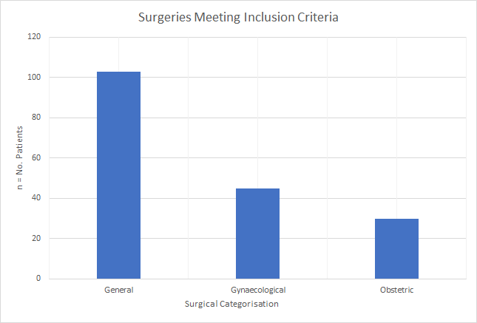
Kingaroy Hospital
Inclusion at Kingaroy Hospital:
n = 178 elective procedures
Data collected between 1st January 2020 and 31st April 2021
Collected from Anaesthesia Record Keeping (ARK) software

Slide 10
Surgical Antibiotic Prophylaxis Guidelines
Surgery | eTG | RANZCOG
Laparoscopic General Surgery | Cefazolin 2 g within 60 minutes before
Open Hernia Repair | Cefazolin 2 g within 60 minutes before
 | Cefazolin 2 g within 60 minutes before + Metronidazole 500 mg within 120 minutes before
Anorectal | Cefazolin 2 g within 60 minutes before + Metronidazole 500 mg within 120 minutes before
 | Clindamycin 600 mg within 120 minutes before
Breast | Cefazolin 2 g within 60 minutes before
Gynaecological | Metronidazole 500 mg within 120 minutes before + Cefazolin 2 g within 60 minutes before | Clindamycin 600 mg within 120 minutes before + Cefazolin 2 g within 60 minutes before
Caesarean | Cefazolin 2 g within 60 minutes before | Cefazolin 2 g within 60 minutes before
Skin | No set recommendation

Slide 11
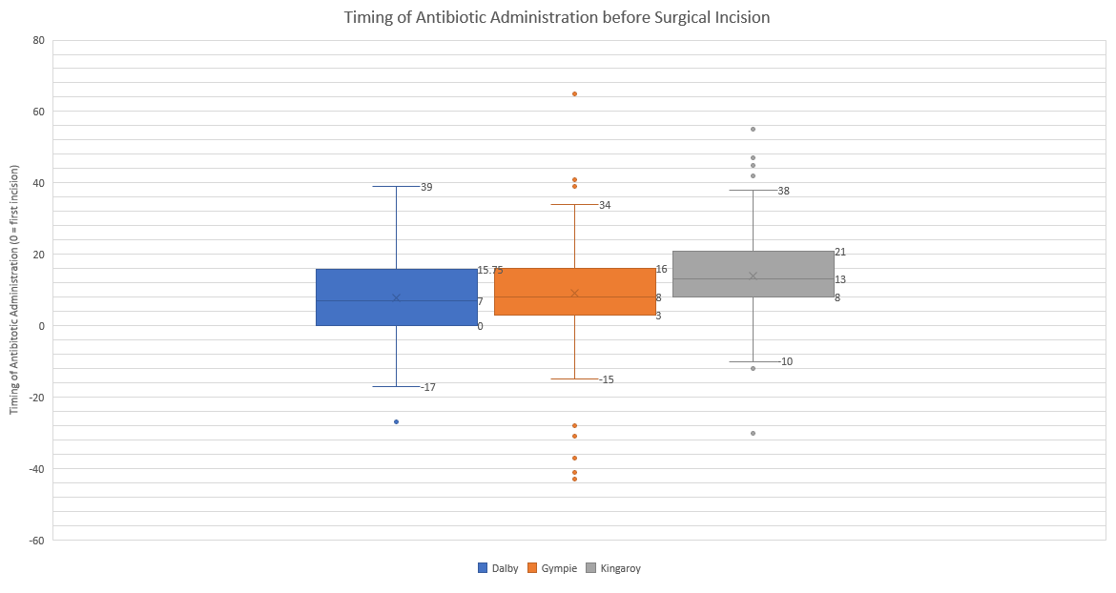
Trends of antibiotic use across all sites
60 Min. Prior to first incision
Time of Surgical Incision

Slide 12
Prophylaxis adherence based on surgery performed

Slide 13
Appropriate use of antibiotics
Factors that may impact Surgical Site Infection:
Douglas et al., (2011) Need at least 30 mins prior to incision to have Minimum Inhibitory Concentration 90% (MIC90)
Fatty tissue 4 μg /g to Staphylococcus aureus resistance breakpoint (Cinotti et al., 2018)
Low anticipatory dose of bacteria (~10⁴ CFU/mL) - 2g cephazolin is adequate (Heffernan et al., 2021)
As previously described appropriate use was determined by:
Antibiotic Type
Antibiotic Dose
Time of Administration (i.e. before first incision and within 60 minutes)
Average Antibiotic Adherence based on the above factors
Kingaroy = 74%
Gympie = 75%
Dalby = 52%

Slide 14
Surgical Site Infections
Kingaroy was the only site with SSI.
12 (6%) SSI were reported
Majority belonged in the general surgery category
7/12 (58%) of procedures resulting in SSI were not adherent to the antibiotic guidelines.

Slide 15
Limitations
1. Audit analysis is still ongoing, however based on raw data it seems likely that the majority of cases with poor adherence are related to inappropriate timing of antibiotic administration.
2. Data collated was limited to Anaesthetic Record Keeping (ARK) software. Timing of antibiotic administration and surgical starting time is therefore dictated by the anaesthetist, leading to potentially inconsistent record keeping, which also impacts limitation 1.
3. Inclusion of skin incisions as a surgical subset was done as it accounts for a significant portion of rural procedures. However, given the lack of guidelines for prophylactic antibiotics in skin based procedures, adherence was calculated purely on timing in those that received antibiotics, which may falsely bring down adherence rates.

Slide 16
Recommendations
Review of process for recording timing of antibiotic administration
We would recommend a review into the process used for the recording of antibiotic administration time, as we realise that there are discrepancies between what is recorded and the actual time of administration.
Appropriate therapeutic guidelines to be generated for skin procedures.
Appropriate and consistent reporting is necessary to fully understand which areas require improvement quality improvement

Slide 17
Vote of thanks to
RMEA – Dr Janani Pinidiyapathirage, Dr Brendan Carrigan & Prof Kay Brumpton
Special thanks to Cameron Mills for generosity of his time and help.

Slide 18
References
Australian Commission on Safety and Quality in Health Care. (2018, March). Hospital-Acquired Complication: Healthcare Associated Infections. https://www.safetyandquality.gov.au/publications-and-resources/resource-library/hospital-acquired-complication-3-healthcare-associated-infection-fact-sheet
Bull A.L., Russo P.L., Friedman N.D., Bennett N.J., Boardman C.J., Richards M.J. (2006). Compliance with surgical antibiotic prophylaxis – reporting from a statewide surveillance programme in Victoria, Australia. Journal of Hospital Infection, 63, 140-147.
Cinotti, R., Dumont, R., Ronchi, L., Roquilly, A., Atthar, V., Grégoire, M., Planche, L., Letessier, E., Dailly, E., Asehnoune K. (2018). Cefazolin tissue concentrations with a prophylactic dose administered before sleeve gastrectomy in obese patients: a single centre study in 116 patients. British Journal of Anaesthesia, 120(6), 1202-1208.
Douglas A., Udy A.A., Wallis S.C. (2011). Plasma and tissue pharmacokinetics of cefazolin in patients undergoing elective and semielective abdominal aortic aneurysm open repair surgery. Antimicrobial Agents Chemotherapy, 55(11), 5238-5242.
Friedman D.N., Styles K., Gray A.M., Low J., Athan E. (2013). Compliance with surgical antibiotic prophylaxis at an Australian teaching hospital. American Journal of Infection Control, 41, 71-74.
Heffernan A., Alawie J., Wallis S.C. (2021). Pharmacodynamic Evaluation of a Single Dose versus a 24-Hour Course of Multiple Doses of Cefazolin for Surgical Prophylaxis. Antibiotics (Basel), 10(5), 602.
Knox M.C., Edye M. (2016). Adherence to Surgical Antibiotic Prophylaxis Guidelines in New South Wales, Australia: Identifying Deficiencies and Regression Analysis of Contributing Factors. Surgical Infections, 17 (2), 203-209.

